Slide 1
Azure Virtual Machines

Slide 2
Agenda
Networking basics (Pre – requisites)
Network Interface Card (NIC)
Hub, Bridge, Switch and, Router
TCP protocol
UDP protocol
OSI Model
TCP/IP Model
Port numbers
MAC Address
IP Address
Public v/s Private IP Address
Subnets
Default Gateway
DNS Working
Virtual Machine Fundamentals (Pre – requisites)
Azure Infrastructure Overview (Pre – requisites)
Fault Domain
Update Domain
Data Center
Availability Zones
Availability Sets
Regions and Region Pairs
Azure Virtual Machines
Overview
SKU and Instance Sizing
Azure Virtual Machines - Scale Sets
Windows Server 2022 VM Creation Demo
Ubuntu 20 LTS VM Creation Demo

Slide 3
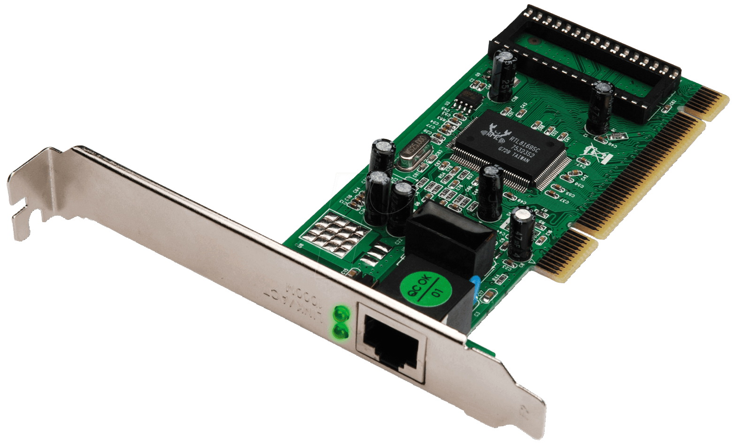
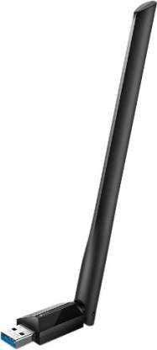
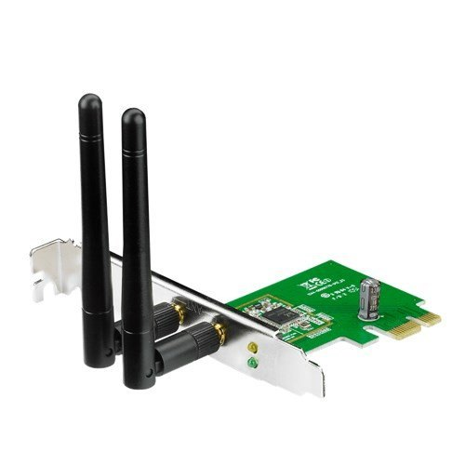
Networking basics - Network Interface Card (NIC)
Hardware component installed in the computer to connect to the internet or LAN.
A computer can have multiple NIC(s) installed.
Different configurations are –
Ethernet/Wireless NIC (PCI-e slot in desktops).
Ethernet/Wireless NIC (Soldered on to motherboard in laptops)
Wireless NIC (USB slot in desktops)
Each NIC has a unique MAC address hardcoded into it by the manufacturer.
Popular manufacturers of NIC(s) include – Cisco, Netgear, TP-Link, Intel.

Slide 4
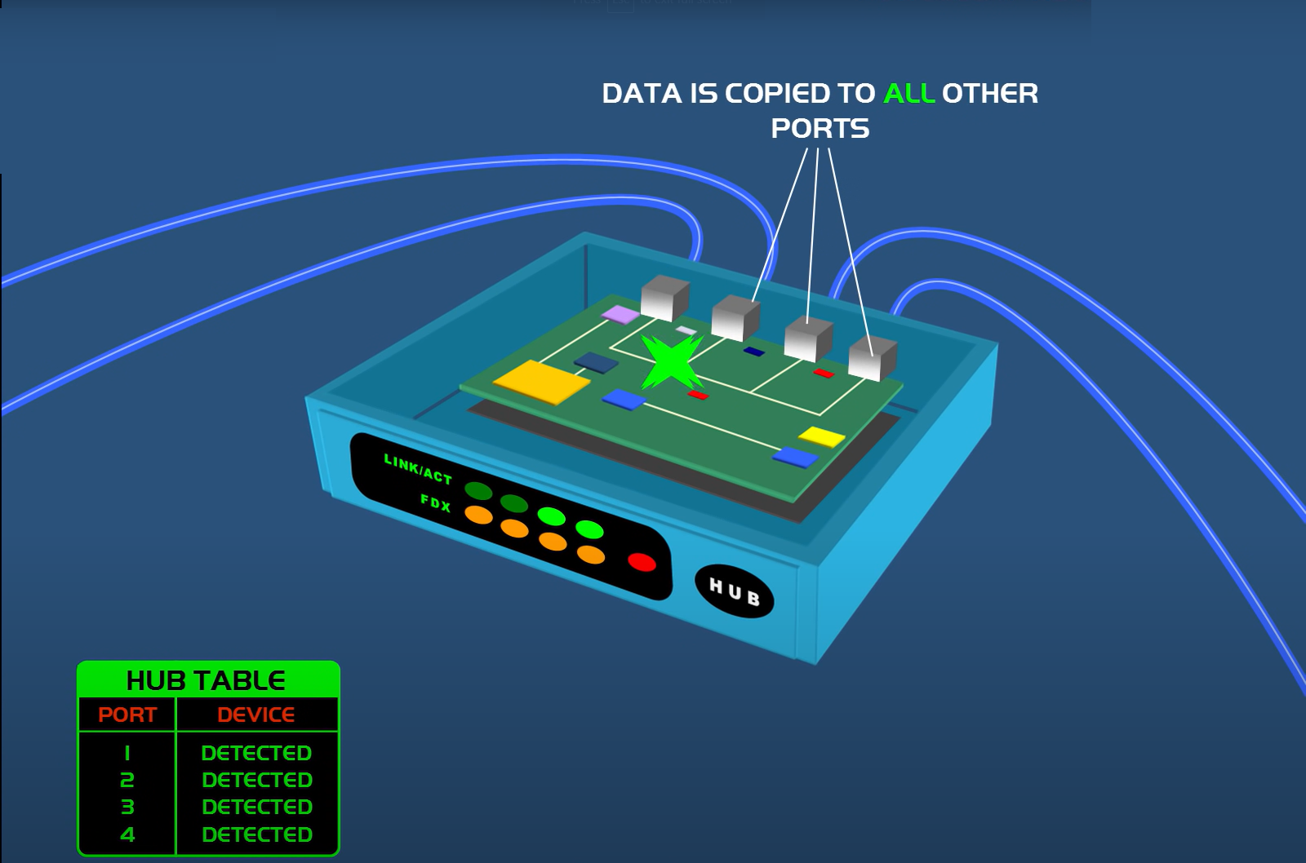
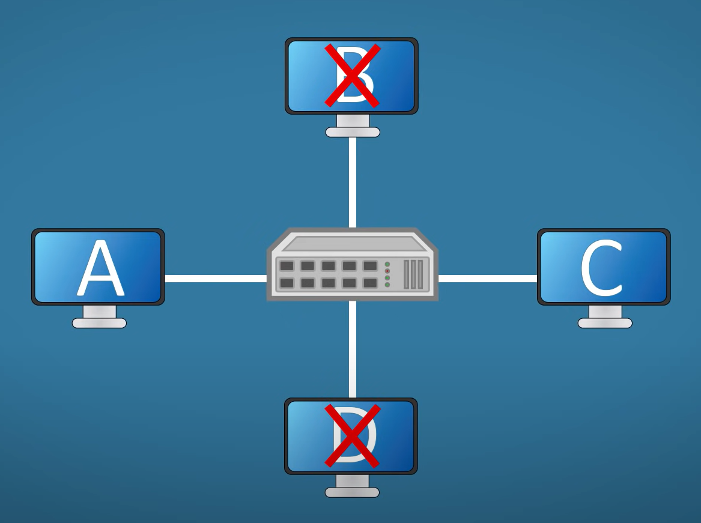
Networking basics – Hub
Hub is a simple device used to connect computers in our network.
It has input ethernet ports by which other computers can connect to it using a RJ-45 cable.
Hub simply re-broadcasts (fans-out) all the data from one computer to all the computers connected to it.
The above process creates unnecessary traffic on the network thereby wasting network bandwidth, also it is a security risk as other hosts can read unintended data; hence hub is considered unintelligent.
Hub is half-duplex, i.e., it cannot send and receive data at the same time.
Hubs are legacy technology and replaced by Switches.

Slide 5
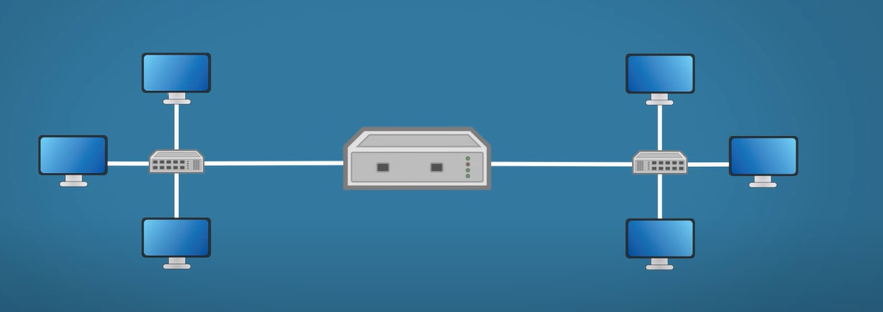
Networking basics – Bridges
Bridges is an improvement over Hub.
Bridges are used to segment a bigger network to smaller segments, where each segment is a small network.
Bridge makes the decision whether to forward / discard the data to the other segment using the source and destination MAC addresses.
Bridge usually have 2 ports.
Bridges are legacy technology and replaced by Switches.

Slide 6
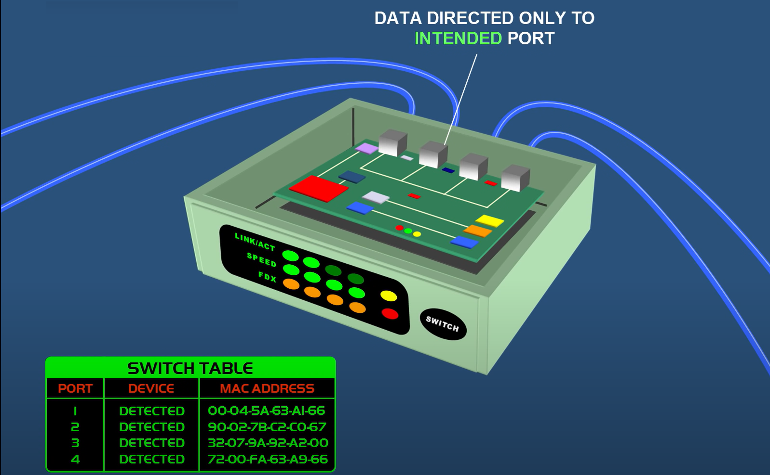
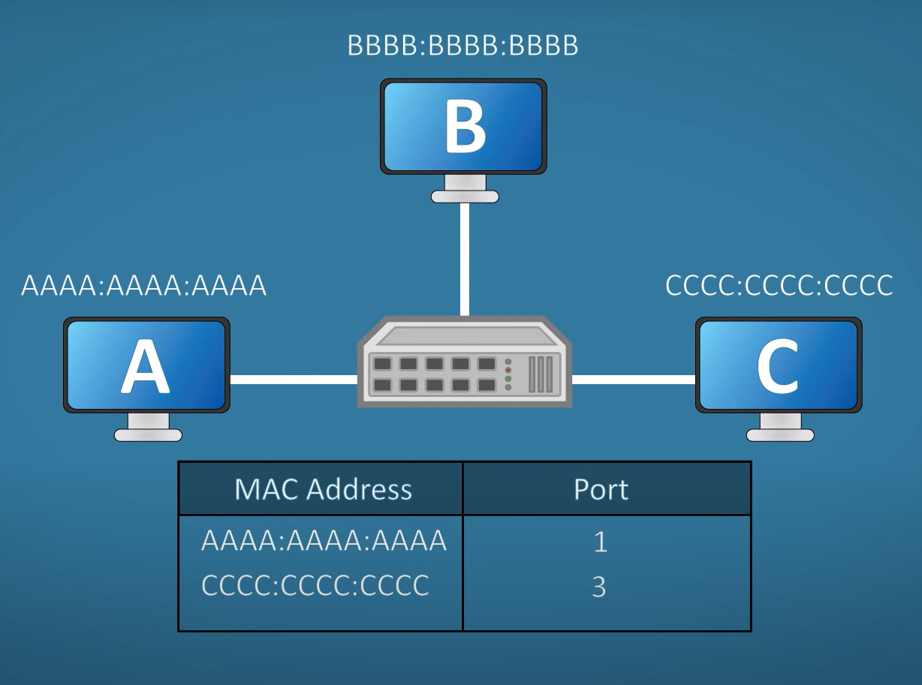
Networking basics – Switches
Switch can learn and remember MAC address of each host connected to it and store them in a switch table.
Switch is full-duplex, i.e., it can send and receive data both at the same time.
Switch has many ports just like hubs and are connected by ethernet cables.
Switch saves network bandwidth by doing a lookup in its switch table and only forwarding data to the intended host.
Other hosts cannot read unintended data, thereby improving security.

Slide 7
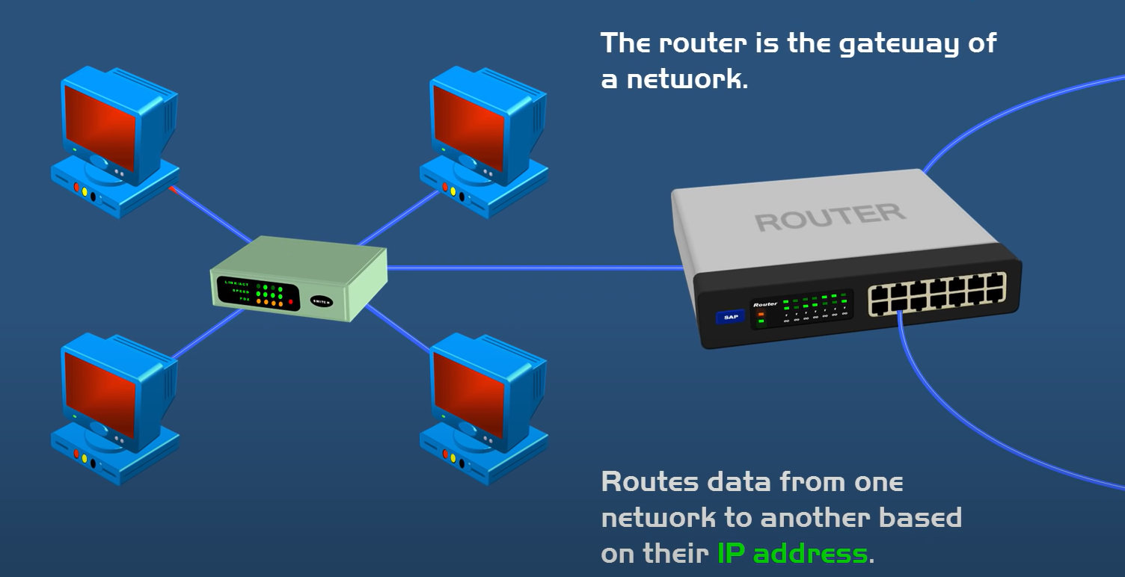
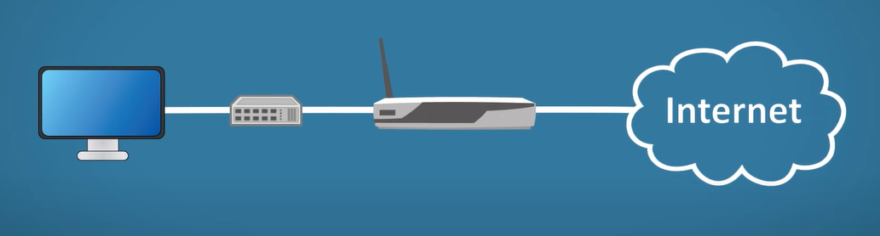
Networking basics – Routers
Hubs, Bridges and Switches are used to exchange data within a local network.
To exchange data outside the network (internet) we need an IP address.
Bridges and Switches only understands MAC addresses.
Router is a device which forwards data based on an IP address.
It usually has 2 ports.

Slide 8
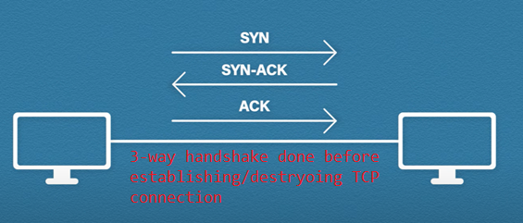
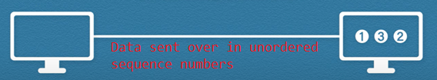
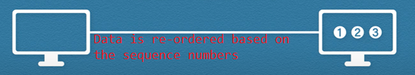

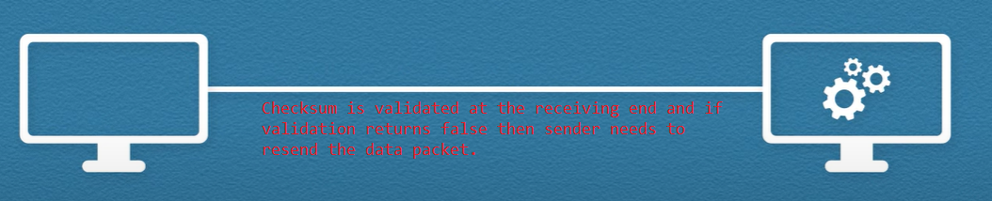
Networking basics – TCP protocol
Transmission Control Protocol (TCP) is the de-facto transport protocol of the internet.
It is a connection-oriented protocol, and a connection is established/destroyed only after a 3-way handshake.
It guarantees reliable transmission of data by –
Acknowledgement (Using acknowledgment numbers)
Sequencing (Using sequence numbers)
Checksum (CRC to validate the data has been tampered or not)

Slide 9
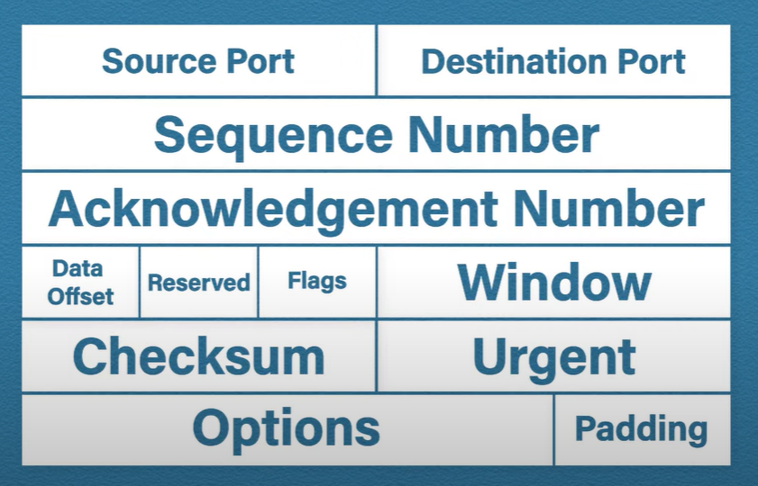
Networking basics – TCP protocol (continued)

Slide 10
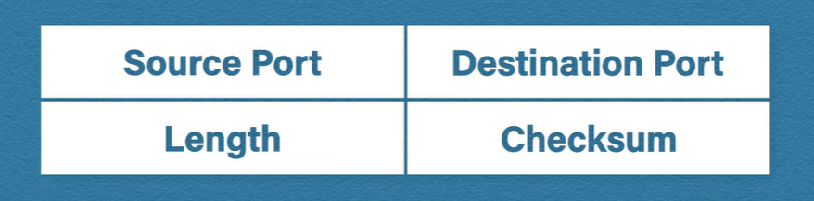
Networking basics – UDP protocol
User Datagram Protocol (UDP) is a connectionless (fire-and-forget) protocol.
Data sent cannot be verified.
Useful for scenarios where too much network latency is not suitable.
E.g. – Voice calls over Internet (VoIP), Instant notifications, etc.

Slide 11
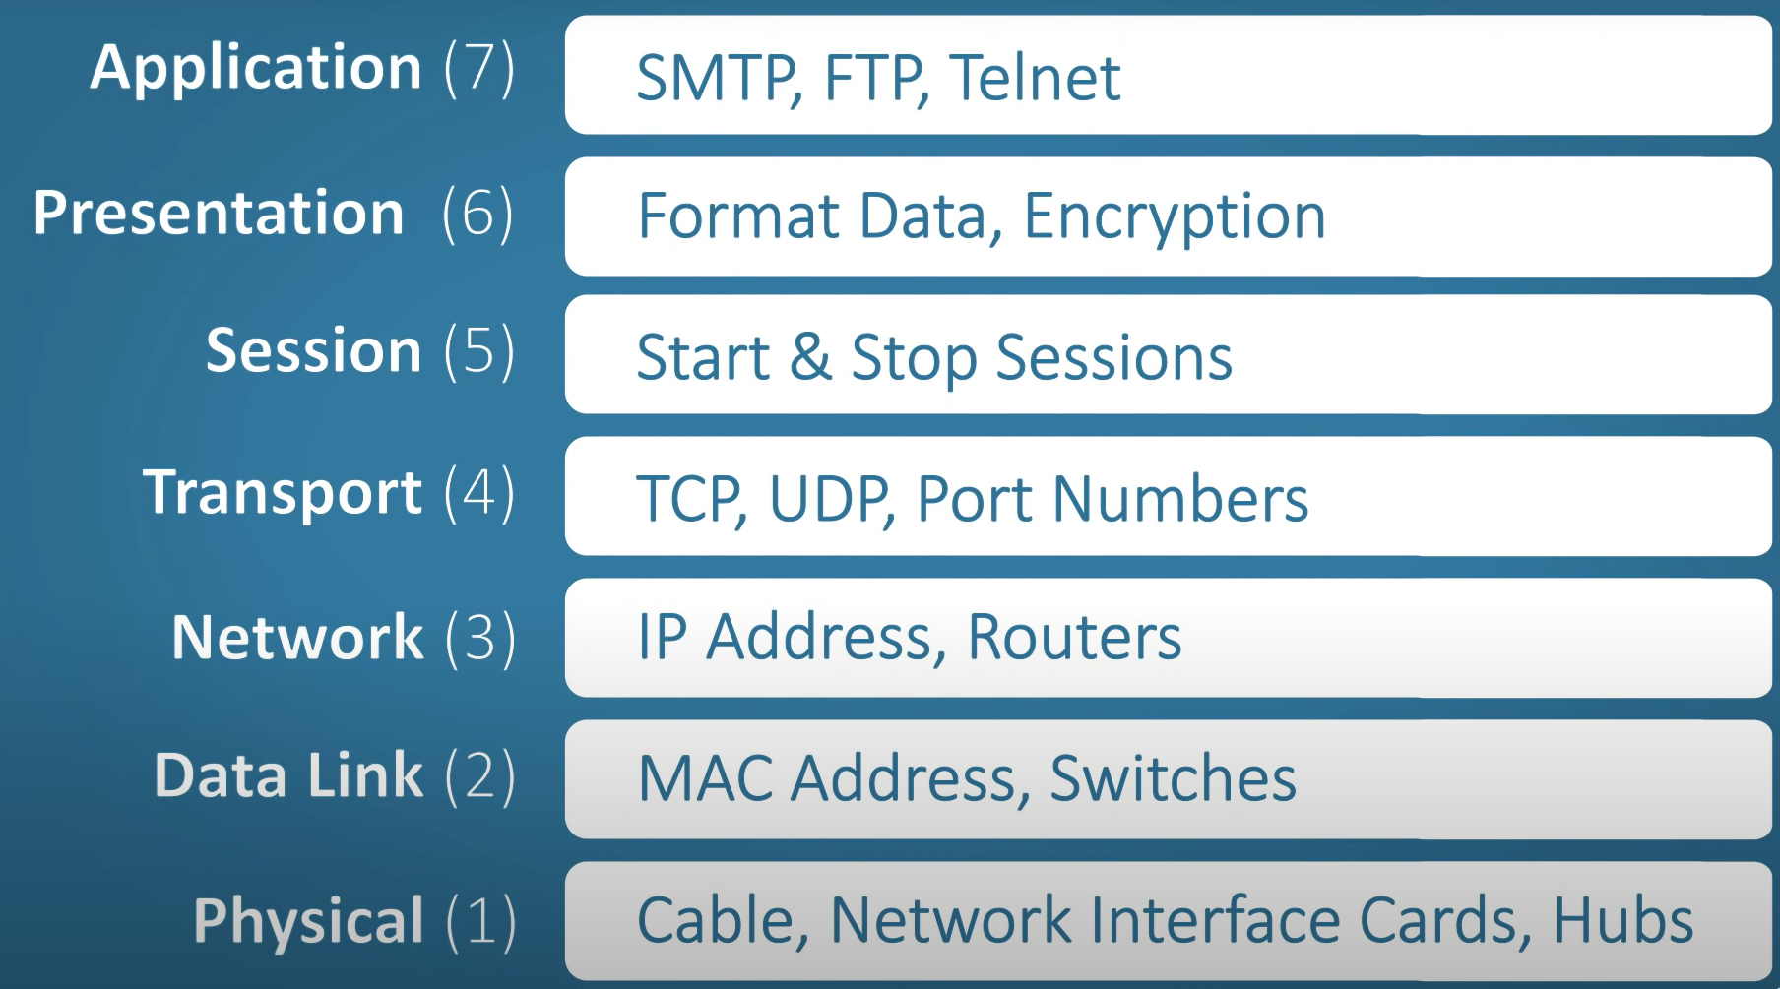
Networking basics – OSI Model
Consists of 7 layers.
Used as a reference to understand how networks operate.
Introduced to standardize multi vendor networking systems.

Slide 12
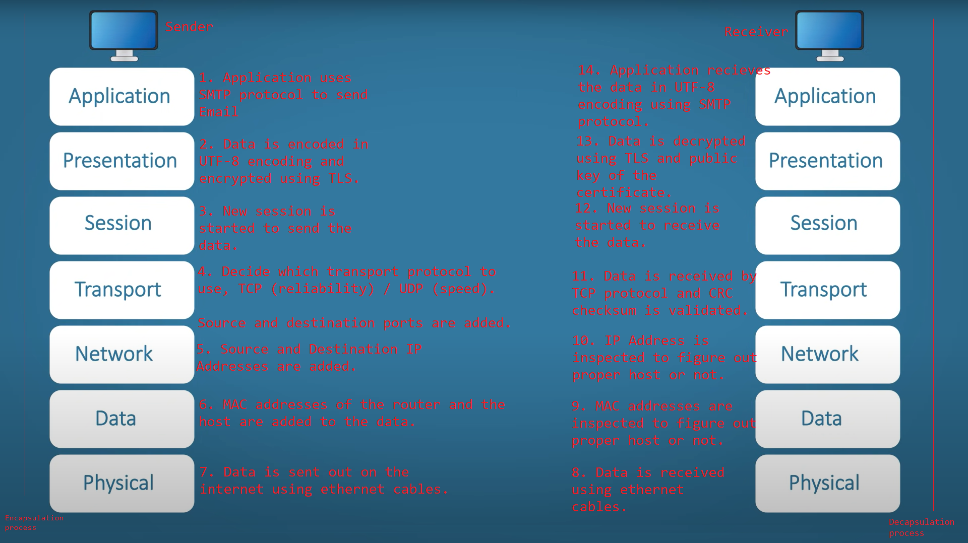

Slide 13
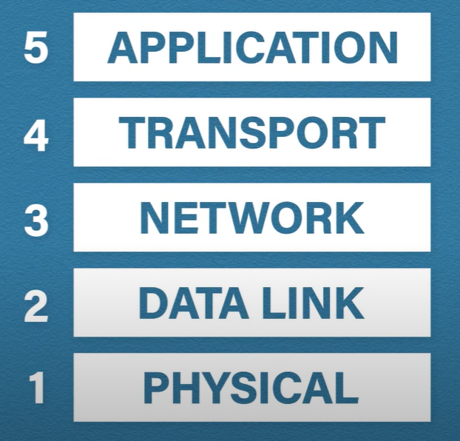
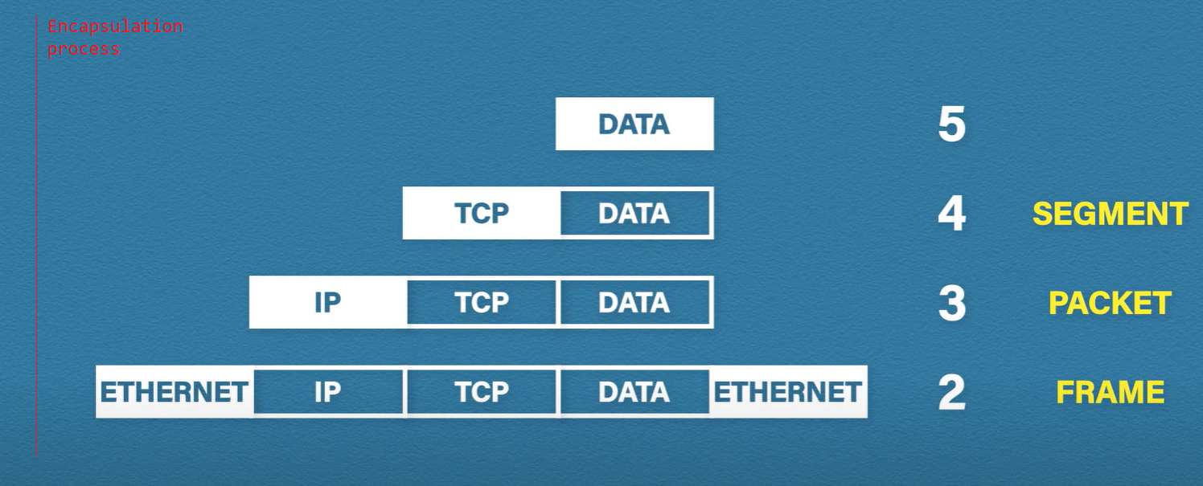
Networking basics – TCP/IP Model
Consists of 5 layers.
Similar to OSI model.
OSI model is used a theoretical reference.
Currently being used in the real world.
Application, Presentation and Session are grouped into one layer in TCP/IP model.
Remaining layers correspond to layer in OSI model.

Slide 14
Networking basics – Port Numbers
Port numbers are associated with an IP address and the transport protocol used (TCP/UDP) and is used as a communications endpoint.
Ports numbers are 16-bit unsigned integers ranging from 0 to 65535.
All port numbers are divided in 3 ranges –
Well known ports (0 to 1023) E.g. – SSH (22), HTTP (80), HTTPS (443), etc.
Registered ports (1024 to 49151) – RDP (3389), SQL Server (1433), MySQL (3306), Postgres (5432), Redis (6379 and 6380), etc.
Dynamic ports (49152 to 65535)

Slide 15
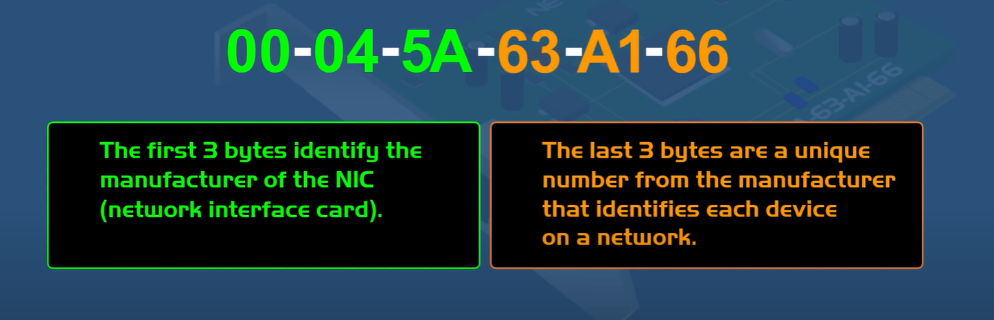
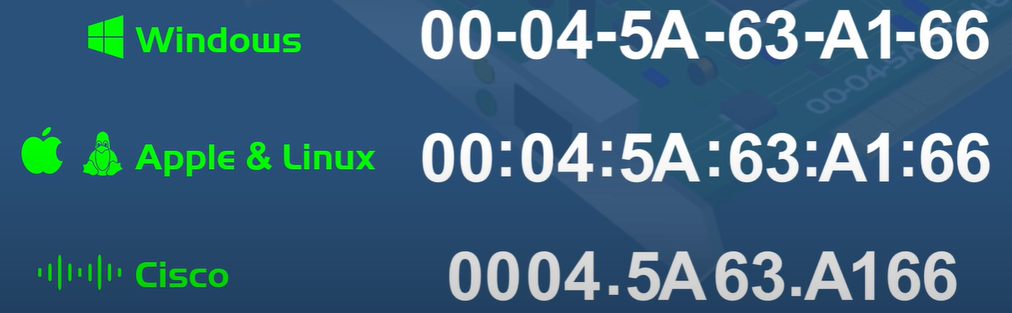
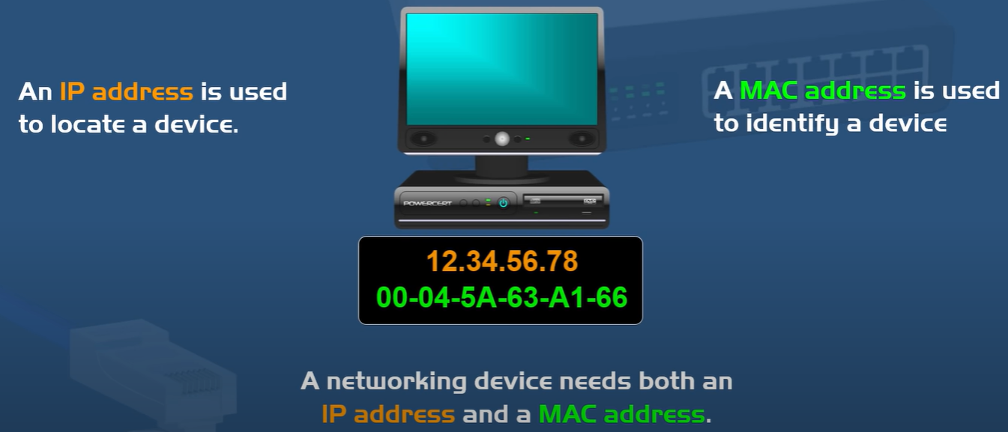
Networking basics – MAC Address
Media Access Control (MAC) Identifier is a unique 6-byte hexadecimal number hardcoded in every NIC used to identify each device on a network.
Sometimes referred to as Physical/Hardware address.
MAC addresses are permanent (hardcoded into a NIC) and never change. (IP addresses may change)
A computer can have many MAC addresses and the relationship goes – 1 NIC : 1 MAC address

Slide 16
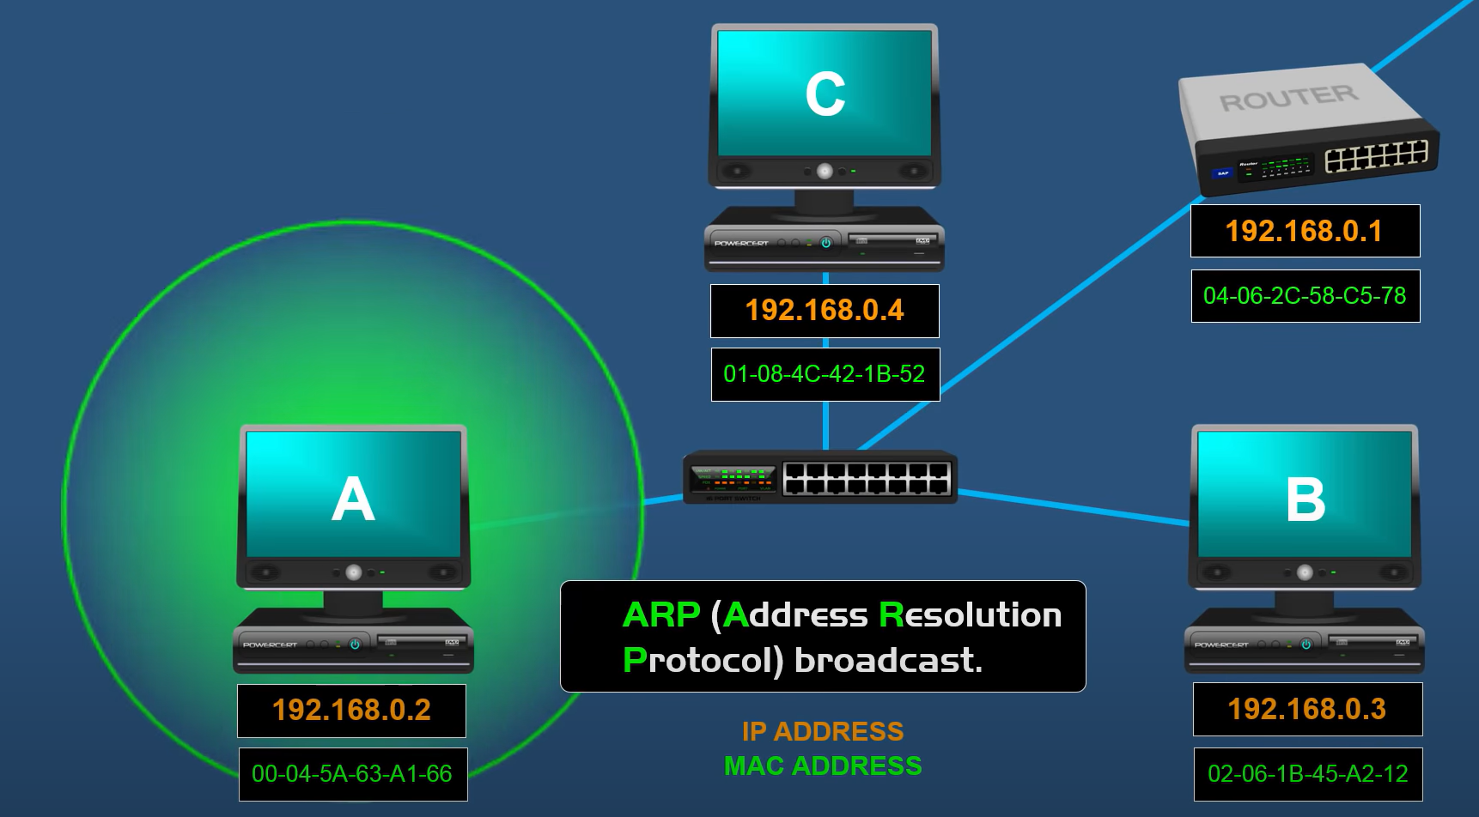
Networking basics – MAC Address (continued)
If Computer A wanted to communicate with Computer B on the same local network, it would –
Inspect Computer B’s IP address
Check if the above IP address is on the same network.
To find out Computer B’s MAC address, Computer A sends an ARP broadcast to every device in its local network.
Once Computer B’s MAC address is obtained, Computer A can begin sending data to it.
To find out the MAC address for the computer –
Windows – ipconfig /all
MacOS and Linux - ifconfig

Slide 17
Networking basics – IP Address
IP Address is a unique identifier assigned to a device which connects to the internet.
It consists of two parts –
Network address
Host address
There are 2 types of IP addresses –
IPv4
Current version of IP addresses, it is a 32-bit numeric address separated by 4 periods.
Each number separated by a period is called an octet. E.g. – 66.94.234.13
Each octet can go up to 255.
There are 4.2 billion unique IP addresses using IPv4 addressing scheme.
IPv6
Next generation of IP addresses
It is a 128-bit hexadecimal address, i.e., 8 sets of 16 bits.
Capable of producing 340 X 10³⁶ unique addresses.

Slide 18
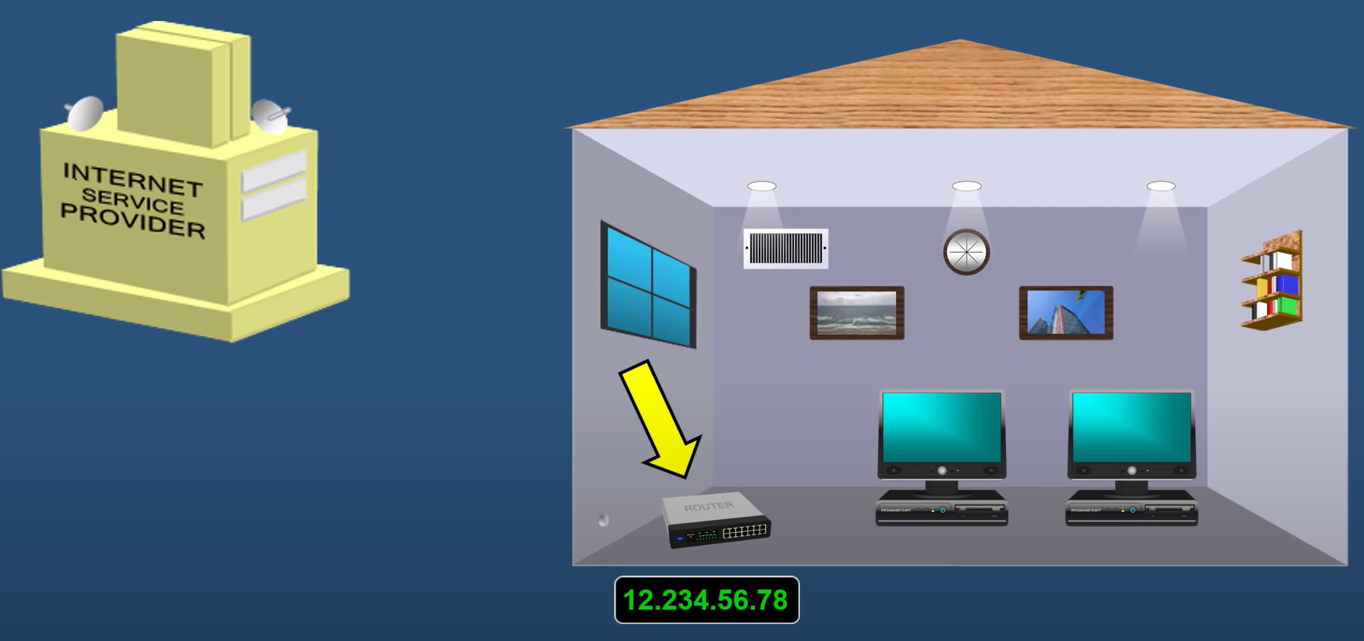
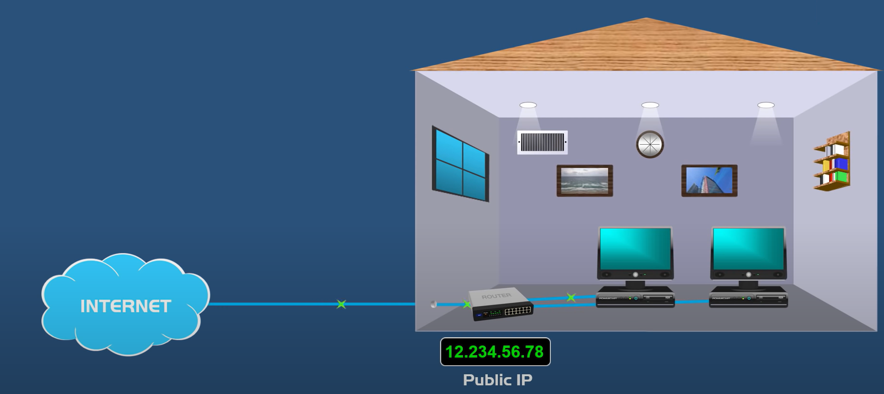
Networking basics – Public v/s Private IP Addresses
There are 2 types of IPv4 addresses – Public and Private.
When we request an internet connection from the ISP, they assign the router a unique public IP address which is registered on the internet.
Public IP address can be viewed by visiting – whatismyipaddress.com
To prevent shortage of public IP address, private IP address was introduced.
Private IP addresses are assigned by a router.

Slide 19
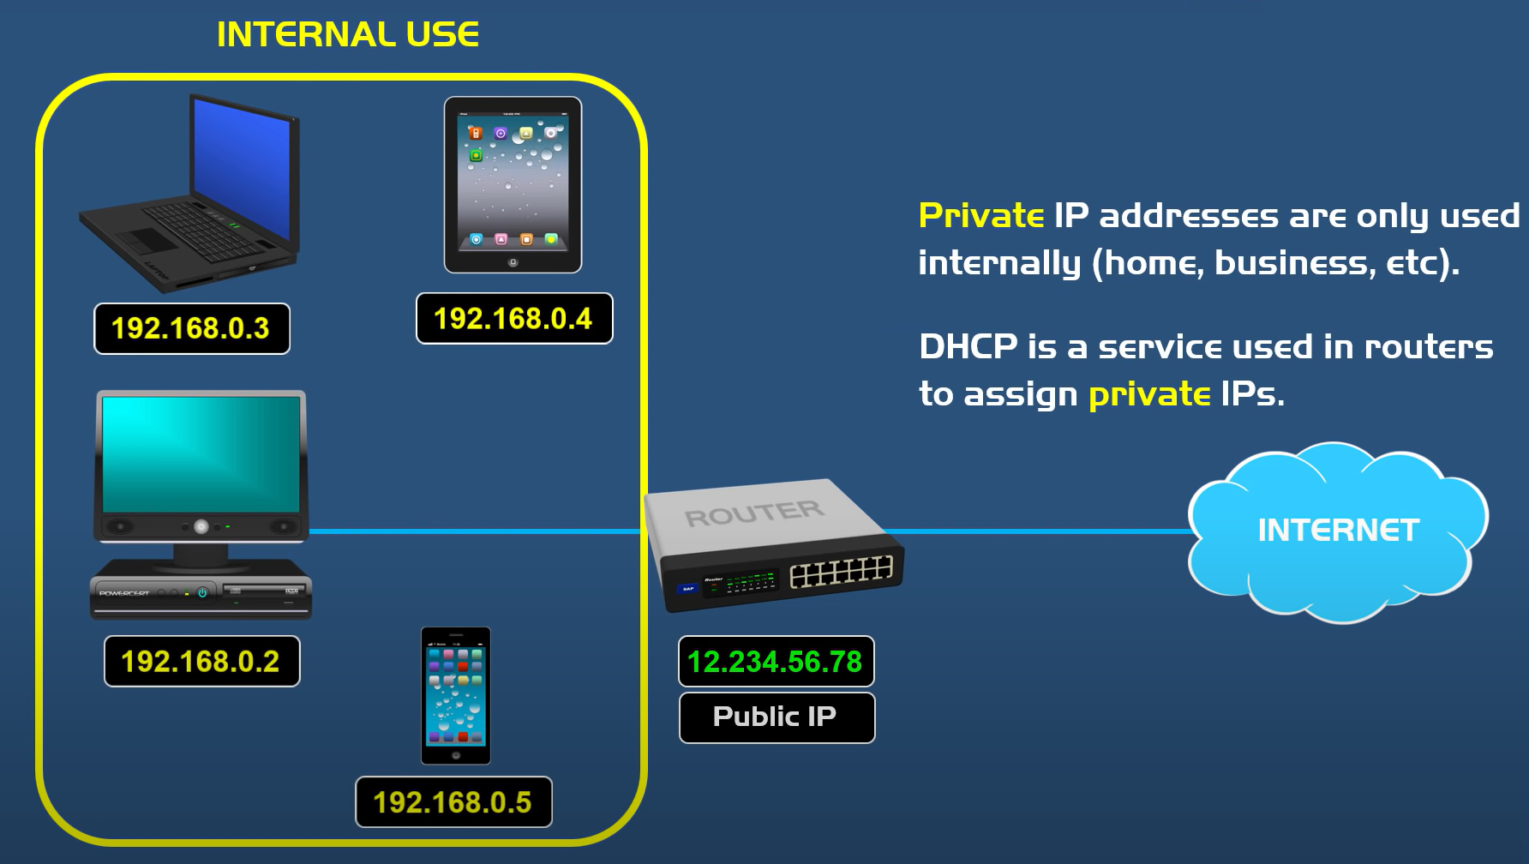
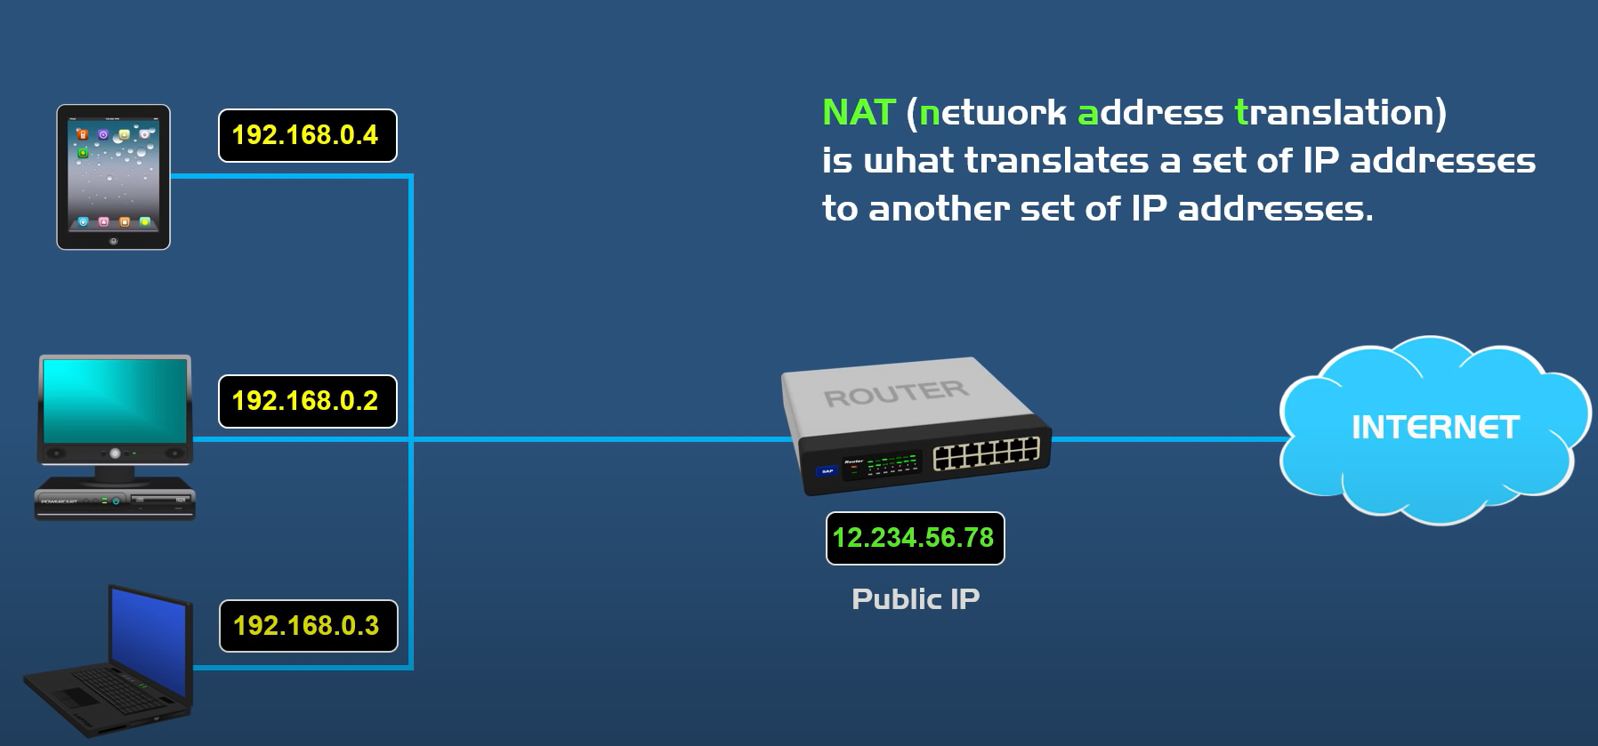
Networking basics – Public v/s Private IP Addresses (continued)
Each device behind the router is assigned a unique private IP address using DHCP service.
To know the private IP address of the computer –
Windows – ipconfig /all
MacOS and Linux - ifconfig
Private IP addresses are translated to public IP address using NAT protocol to connect to the internet.
There are 3 classes of Private IP addresses –
Class A – (10.0.0.0 to 10.255.255.255) – Used in large sized organizations
Class B – (172.16.0.0 to 172.31.255.255) - Used in medium sized organizations
Class C – (192.168.0.0 to 192.168.255.255) – Used in small sized organizations or homes.

Slide 20
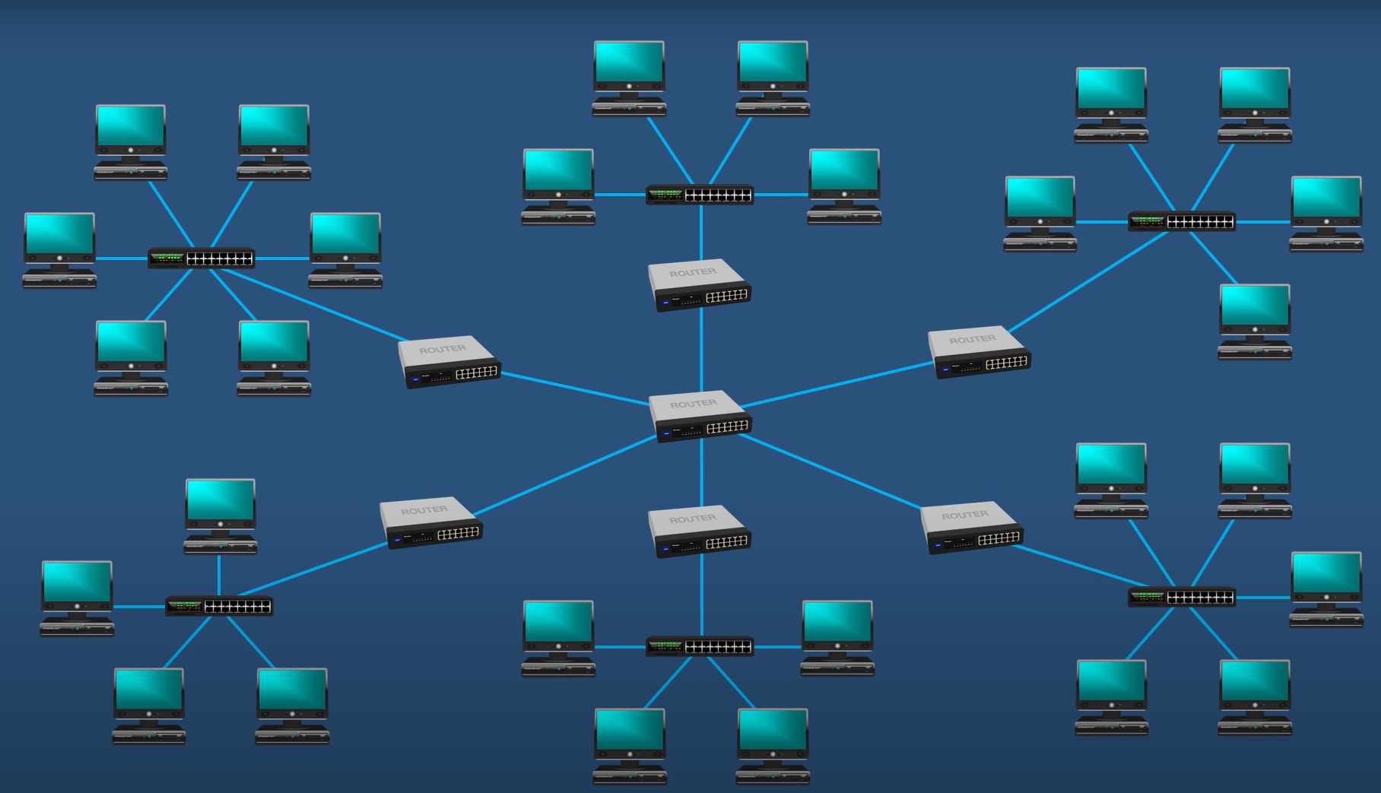
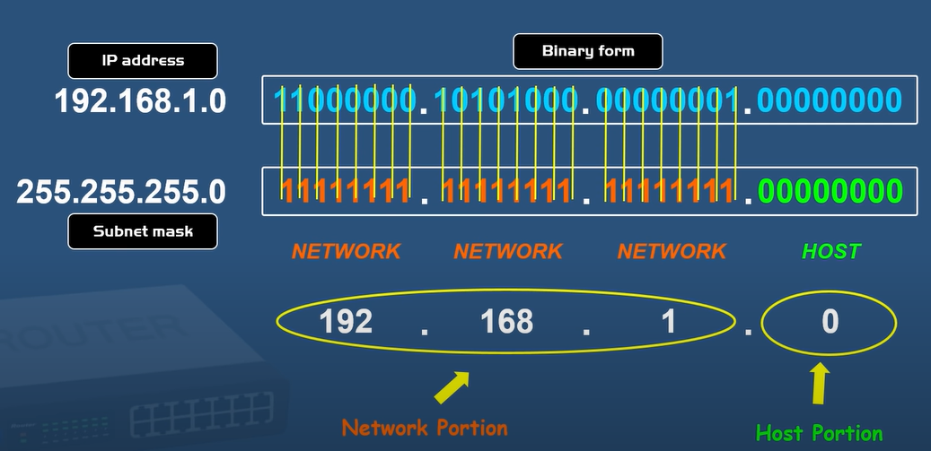
Networking basics - Subnets
IP addresses have a network and a host part, so networks for better manageability can be broken down in smaller parts called subnets and this is called subnetting.
To send data between computers in different subnets, the sender computer needs to know if the receiving computer is in the same subnet or not.
This can be done by checking the network portion of the IP address.
If network portion of both sender and receiving applications are same, then it is the same network.
To obtain the network portion of the IP address we do a bitwise AND operation of the private IP address with the subnet mask.

Slide 21
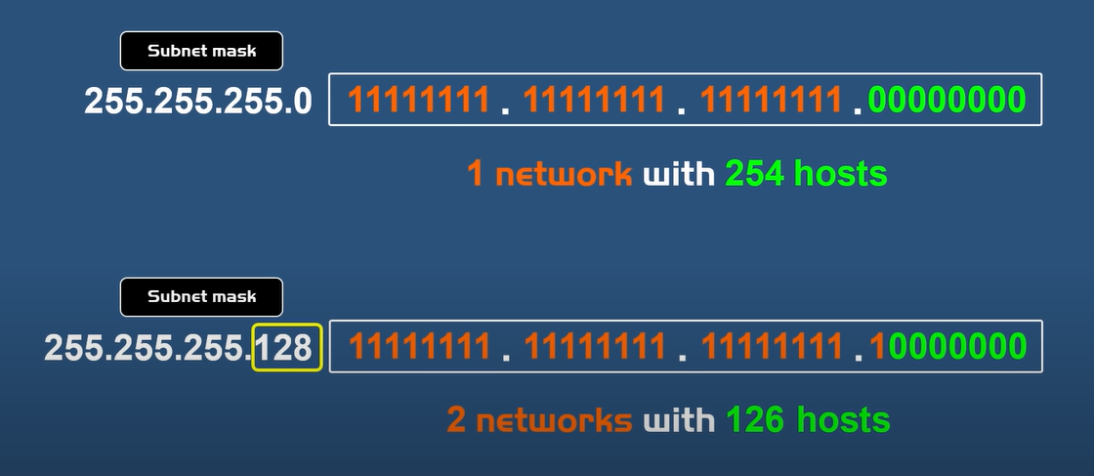
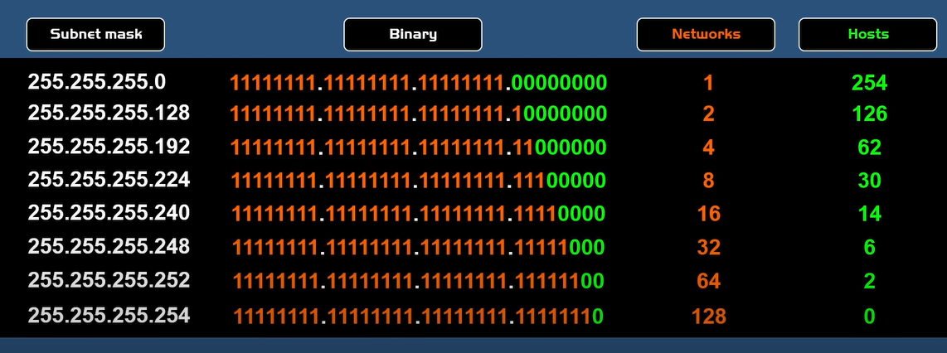
Networking basics – Subnets (continued)
When developing a network infrastructure, to decide how many hosts can be in a subnet, a network engineer borrows some of the bits from MSB from the subnet mask.
2 hosts (11111111 & 00000000) are reserved in the host part by broadcast and network address, respectively.
Private IP can be written using CIDR (Slash notation) where the number of 1’s from a subnet mask is written as a suffix to the private IP address.
E.g. – 192.168.1.0/24 (24 1’s in the subnet mask)

Slide 22
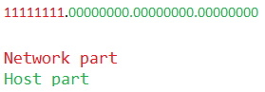
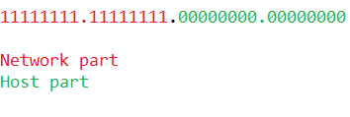
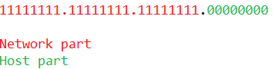
Networking basics – Subnets (continued)
Subnet masks come in 5 classes out of which 3 are important.
These classes indicate how many hosts can be accommodated inside each subnet.
Subnet Class | First Octet (Private IP address) | Subnet Mask | Number of Supported Hosts per Network Supported Hosts per Network | Calculation
Class A | 1-126 | 255.0.0.0 | Over 16 million
Class B | 128-191 | 255.255.0.0 | 65,000
Class C | 192-223 | 255.255.255.0 | 254

Slide 23
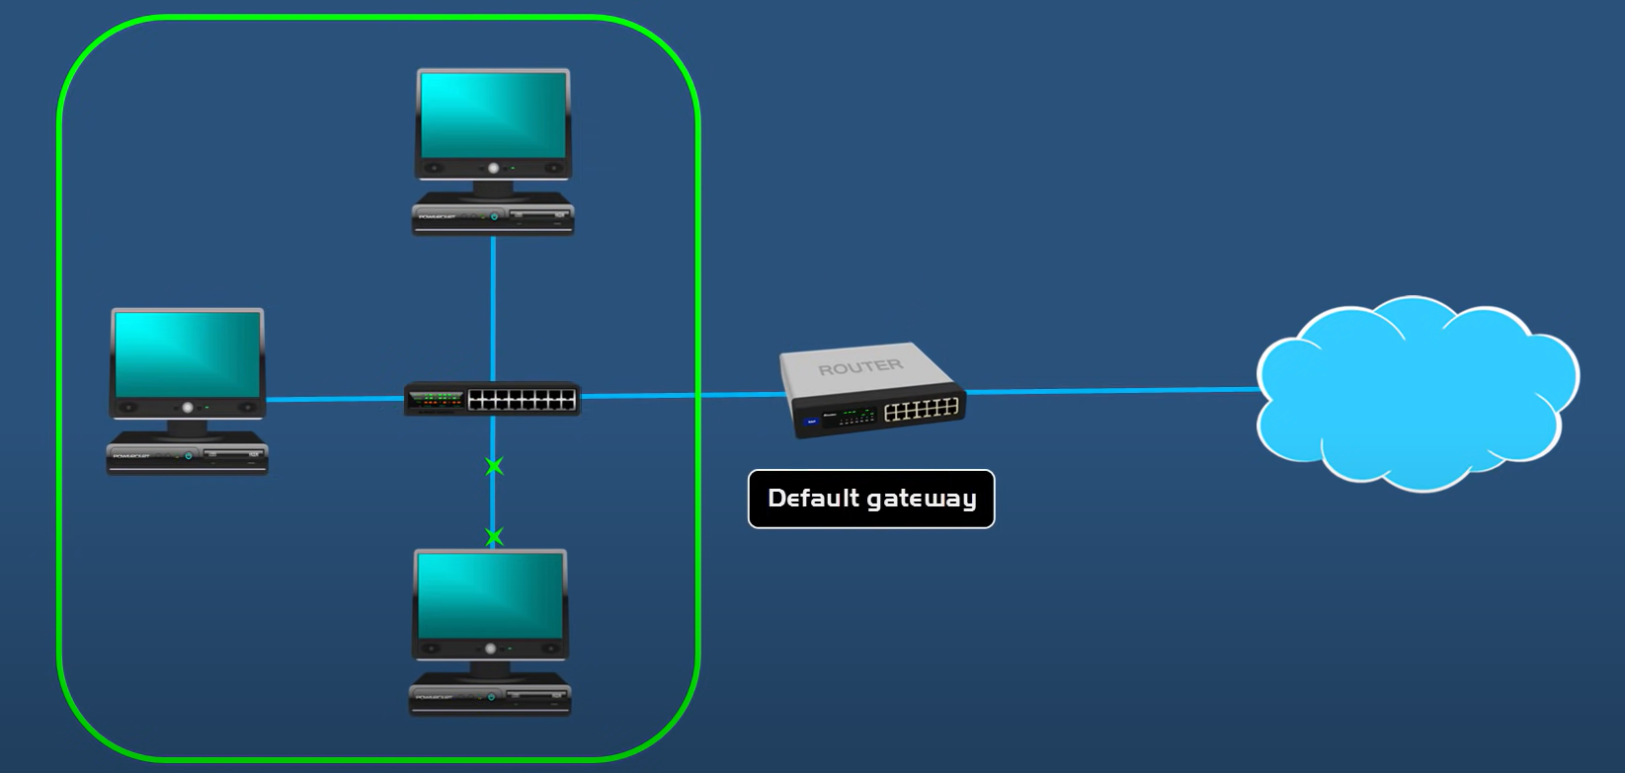
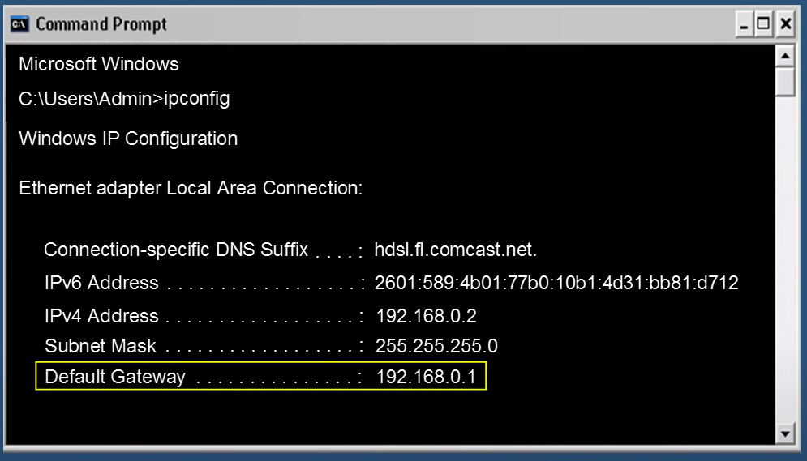
Networking basics – Default Gateway
Device Gateway is a device that forwards data from one network to another. (Typically, the router)
Data comes through / exits the network by the default gateway.
The term default indicates it’s the first device when the data needs to exit through the network to the public internet.
The default gateway (router) IP address can be found by ipconfig in Windows.

Slide 24
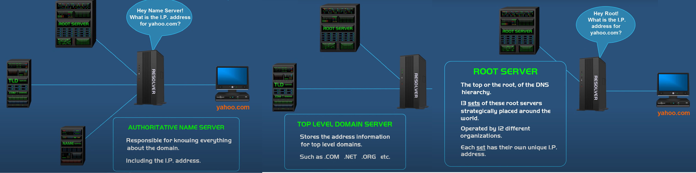
Networking basics – DNS Working
Domain Name System (DNS) resolves domain names to IP addresses.
It works as follows –
User enters yahoo.com in the browser
Computer checks yahoo.com is present in hosts file or not
If not, it forwards the request to the ISP recursive resolver
If not found in ISP resolver, the resolver forwards the request to the Root DNS server.
Root DNS inspects the TLD (.com/.net/.org) and routes it to the appropriate DNS server.
The TLD DNS server forwards the requests to the appropriate Authoritative Name Server.
The Authoritative Name Server has a lookup table of the all the websites of domain names and IP address, and it returns the IP address to the default gateway.
The default gateway caches the response and raises an ARP broadcast to find out the MAC address of yahoo.com

Slide 25
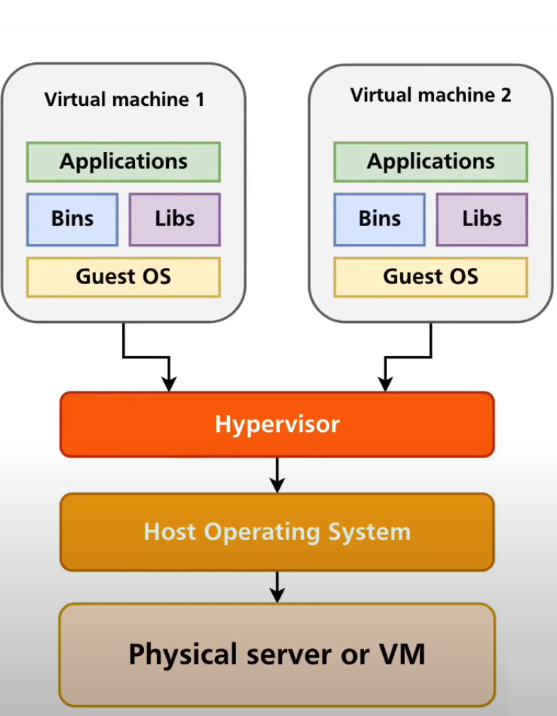
Virtual Machines Fundamentals
Virtual Machines (VM) is a virtual environment functioning as a full computer having its own memory, storage, processing.
Each Virtual Machine is siloed away from each other and allocated resources from the host which they are installed on.
Hypervisor is the software which manages the Virtual machines on the host computer.
Two types of hypervisors –
Type 1 – (Bare Metal: i.e., installed directly on the host) – E.g. : VMware ESXi
Type 2 – (Hosted: i.e., installed on the host operating system as an application) – E.g. : VMware Workstation and Oracle VirtualBox.
VM use cases –
Deploying web servers
Trying out a new OS
Access malware infected files
Testing applications which need a different OS

Slide 26
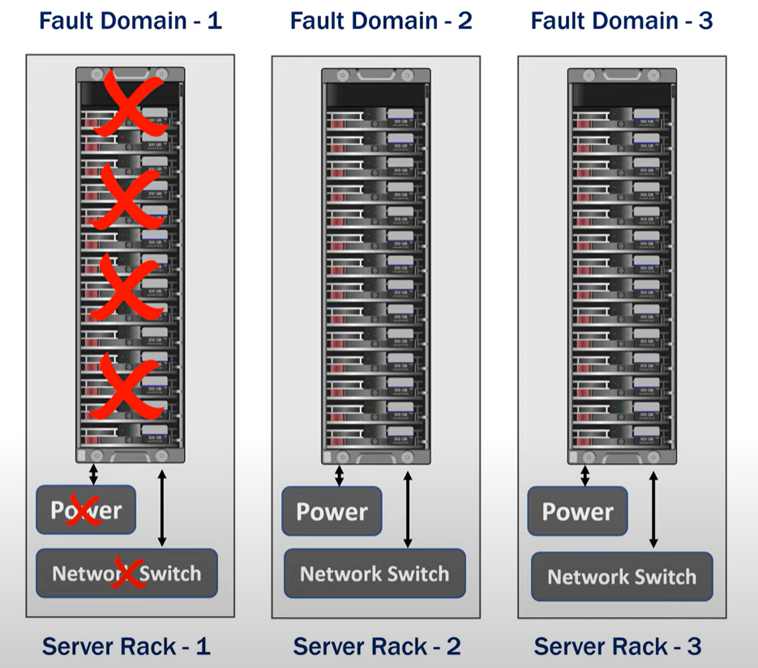
Azure Infrastructure Overview – Fault Domain
Fault Domains are collection of VM(s) sharing a common power source, cooling and a network switch.
Fault Domains minimize the impact of hardware failures, network outages, power failures and power surges.
All the resources become unavailable if there is a failure in a fault domain.

Slide 27
Azure Infrastructure Overview – Update Domain
Update domains are group of virtual machines which can be rebooted at the same time for planned maintenance, OS updates or patching.
Azure will only reboot computers in one update domain at a time.
All virtual machines having same update domain will reboot at the same time.

Slide 28
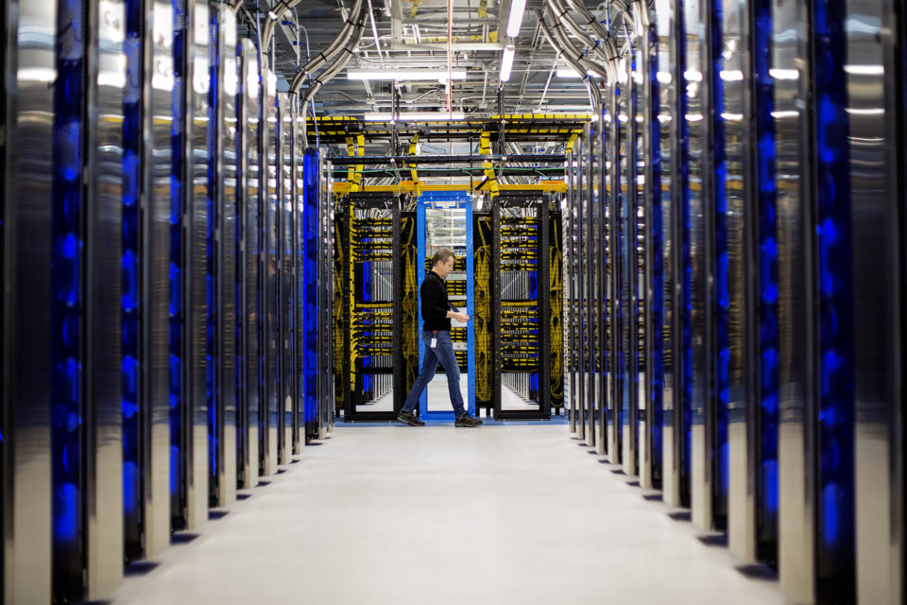
Azure Infrastructure Overview – Datacenters
A datacenter is a physical rack of computer servers.
Datacenters are building blocks of Azure Infrastructure.
Azure has over 200+ data centers dispersed all over the world.
(E.g. – East US, West US, Central India, South India, South-Central India)

Slide 29
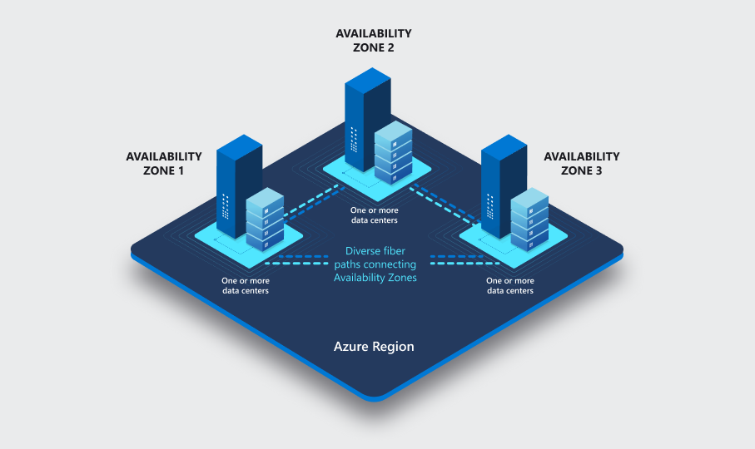
Azure Infrastructure Overview – Availability Zones
Azure Availability Zones are physical locations(buildings) in an Azure region which are fault tolerant.
Availability zones are connected by very fast network which have a round trip of latency less than 2 ms
Typically, we have 3 availability zones.
Each zone is designed in such a way even if one zone is down the remaining two zones will be functional.

Slide 30
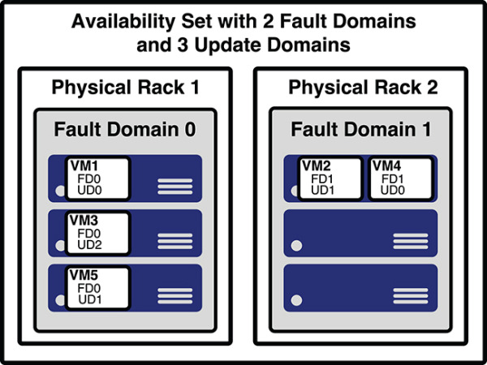
Azure Infrastructure Overview – Availability Sets
Availability Set is a logical grouping of VM(s) for redundancy and high availability.
Azure allocates at least 2 Fault Domains and 5 Update Domains automatically to an availability set.
Azure guarantees up to 99.95 % SLA if VM(s) are deployed in an availability set.

Slide 31
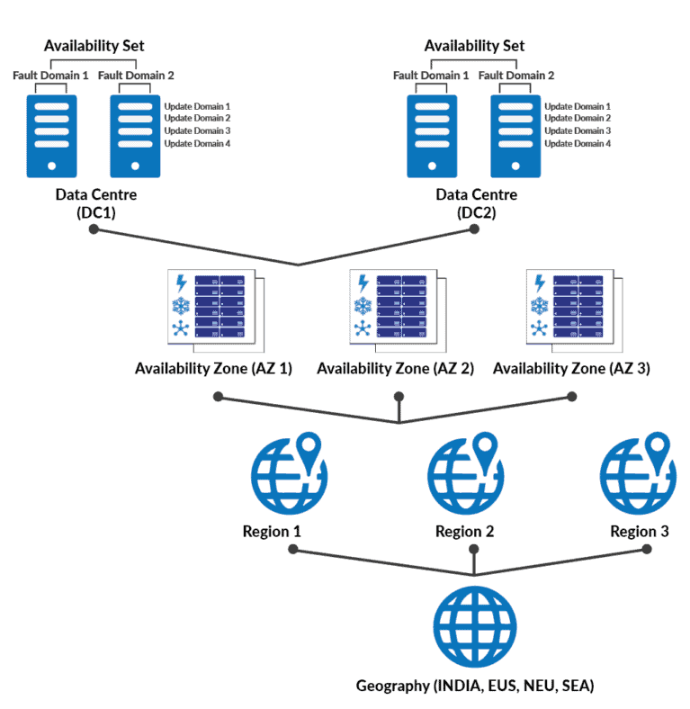
Azure Infrastructure Overview – Regions and Region Pairs
Datacenters in Azure are grouped into geographical regions.
Advantages of Regions include –
Being complaint for regulated data
Financial
Health care
Credit Cards
Being legally complaint
Reduce network round trip latency by choosing nearest region.
Each region is paired with a nearest geographical to ensure high availability.
Primary Region | Secondary Region
East US | West US
Central India | South India
North Europe | West Europe

Slide 32
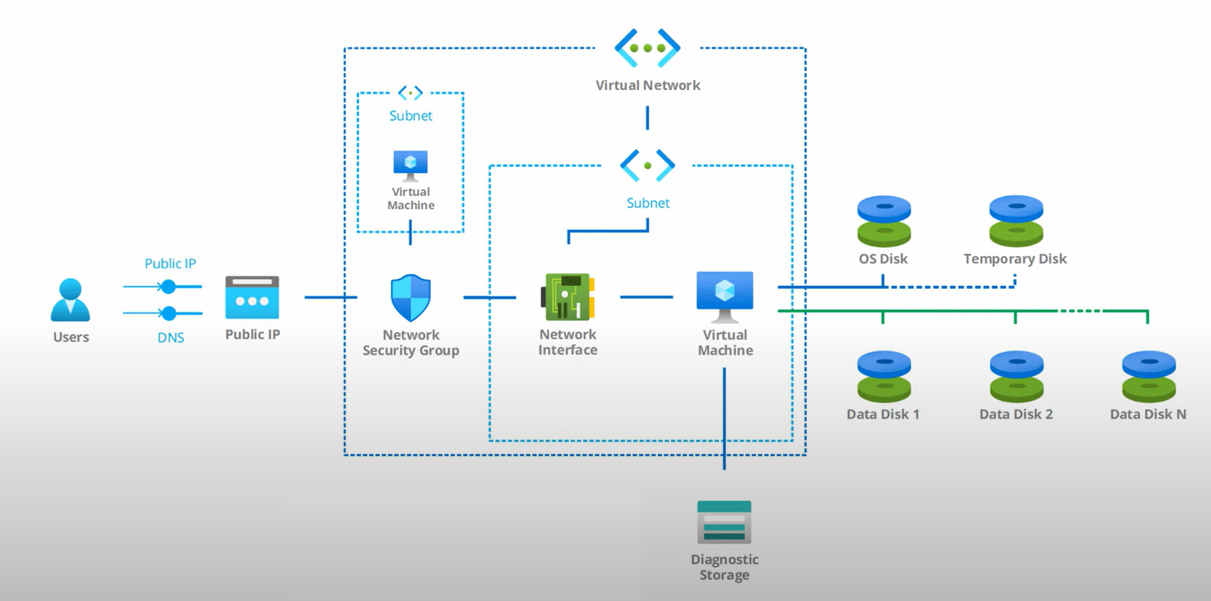
Azure Virtual Machines
Azure Virtual Machines are an IaaS solution by Azure to run virtual machines in Azure Cloud.
While creating an Azure Virtual Machines the following resources are created as linked resources –
1. Temporary / Ephemeral Disks
This is a fast temporary storage (SSD) to store temporary files.
Contents of this disks might be lost during maintenance.
Don’t store sensitive information on this disk.
2. Data Disks
We can increase the storage of our Virtual Machines by adding data disks.
3. Network Interface Card (NIC)
1 MAC address and 1 Private IP address assigned to this NIC.
4. Subnet
A subnet will be created whenever we create a virtual machine which can be part of a virtual network.
5. Network Security Group (NSG)
Filters any unwanted inbound/outbound traffic (Acts like a router)
6. Public IP
When we create the Azure Virtual Machine, we are allocated a static public IP resource from Azure for NAT process to take place.
7. Diagnostics logs
We can log the boot logs and other bootloader information in Azure Storage Tables in a separate storage account.

Slide 33
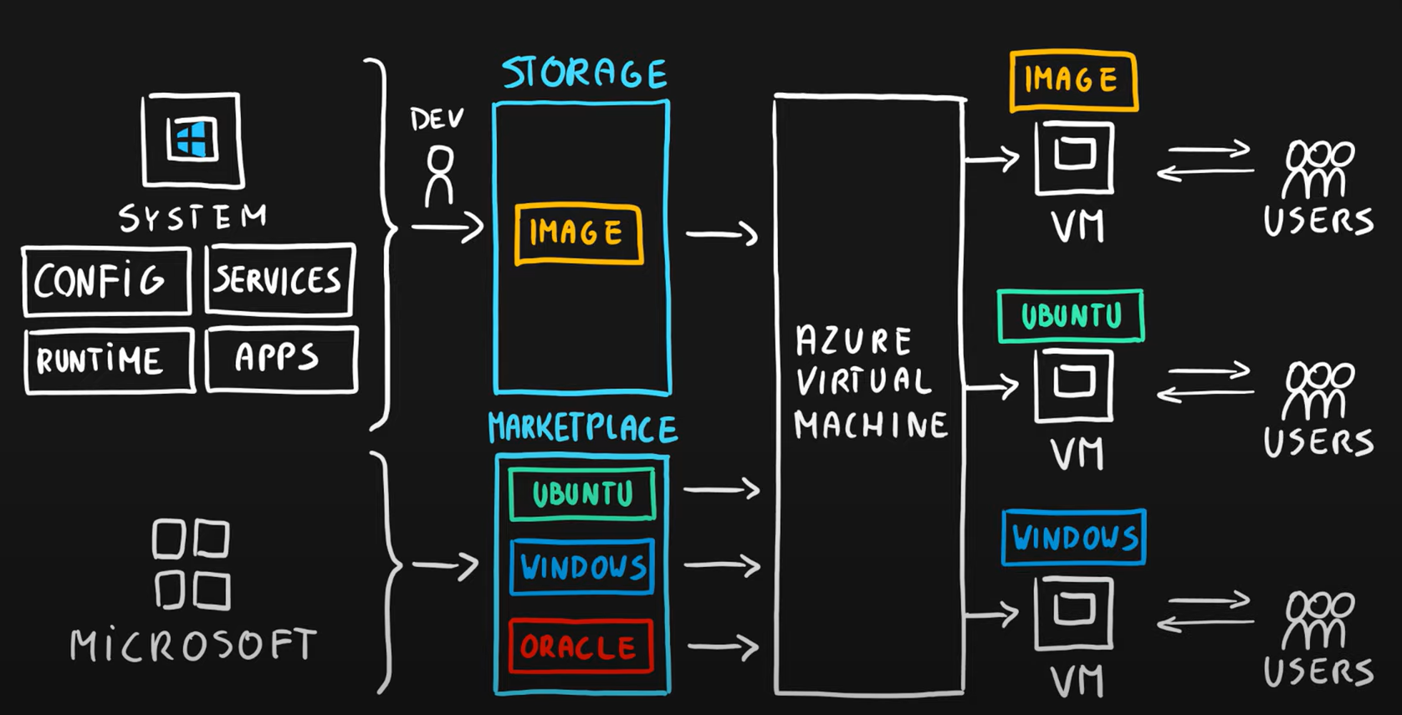
Azure Virtual Machines - Overview
Azure Virtual Machines can be created in two templates -
Marketplace Images
Lift-N-Shift (Upload an on-premise VHD image to page blobs GPv2 storage account)
We can create Virtual Machines in Azure using –
Azure Portal
ARM template
Az Cli
We can save costs on the virtual machines having Windows operating systems if he already have a license with us, this process is called Azure Hybrid Benefit.

Slide 34
Azure Virtual Machines – SKU and Pricing
Azure Virtual Machines are divided into 5 SKU(s) –
General Purpose (B and D series)
This SKU has Balance CPU to memory ratio (Small MVC styled web apps, SPA(s))
Compute Optimized (F series)
High CPU to memory ratio (Web servers)
Memory Optimized (E series)
High memory to CPU ratio (Relational databases, Redis caches)
Storage Optimized (L series)
High Disk Throughput (SQL, NoSQL databases)
GPU Optimized (N series)
Has dedicated graphics processing unit (Graphics rendering, ML/DL model training, etc.)
High performance compute (H series)
Weather modelling, Seismic processing, Fluid Dynamics, etc.
Pricing for the Azure Virtual Machines are calculated monthly and can be viewed here.

Slide 35
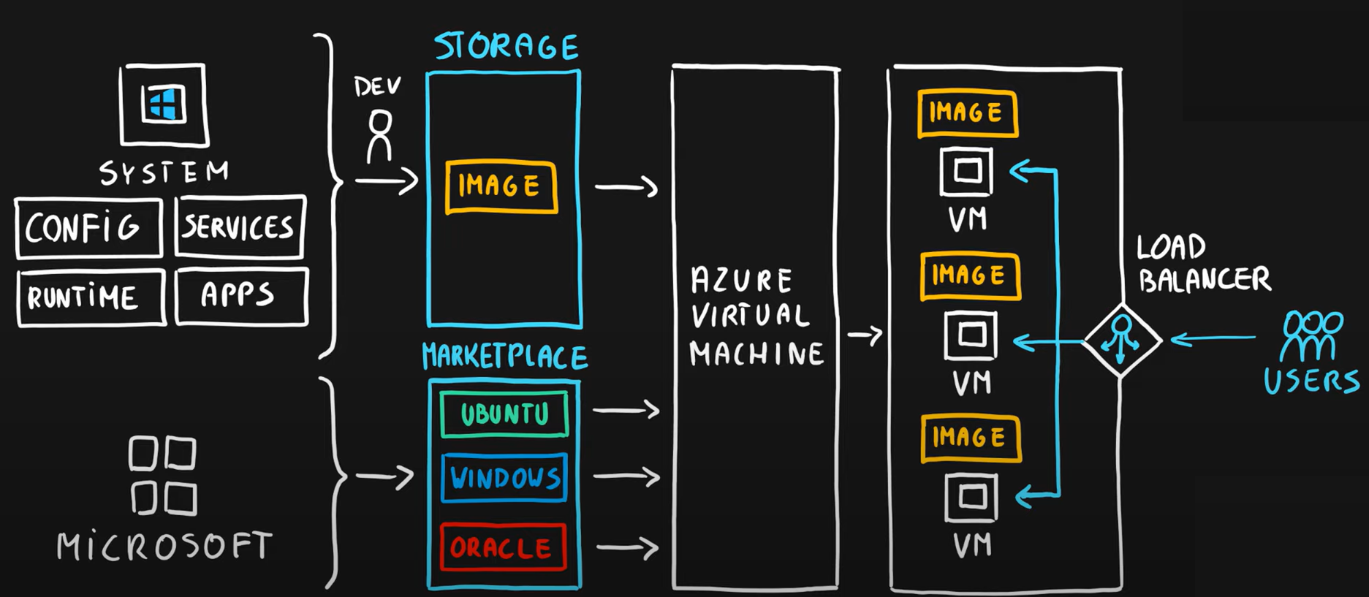
Azure Virtual Machines – Scale Sets
Azure Virtual Machine is a cluster of load balanced Virtual machines.
All VM(s) in a scale set are identical.
Azure Load Balancer service also gets automatically created as part of the deployment.
Autoscaling can be configured by –
Performance metrics (CPU / Memory / Storage)
On a schedule
Autoscaling can scale out up to 1000 VM(s) in a single availability zone.

Slide 36
Windows Server 2022 VM Creation Demo

Slide 37
Ubuntu 20 LTS VM Creation Demo

